Slide 1

Summer Internship Presentation
(AUGUST-DECEMBER 2025)
Jagannath International Management School
Vasant Kunj, New Delhi - 110070
(Affiliated to Guru Gobind Singh Indraprastha University, New Delhi) Recognized u/s 2(f) by UGC & Accredited with ‘A+’ Grade by NAAC NIRF Rank Band 201-300 under College Category
Participant of UNGC New York and ISO 9001:2015 Quality Certified

Slide 2
Programme :
Department :
BCA
Information Technology
Semester :
Batch :
Topic :
V
BCA-(2023-26)
Summer Internship Presentation
Enrollment No. :
02214202023

Slide 3
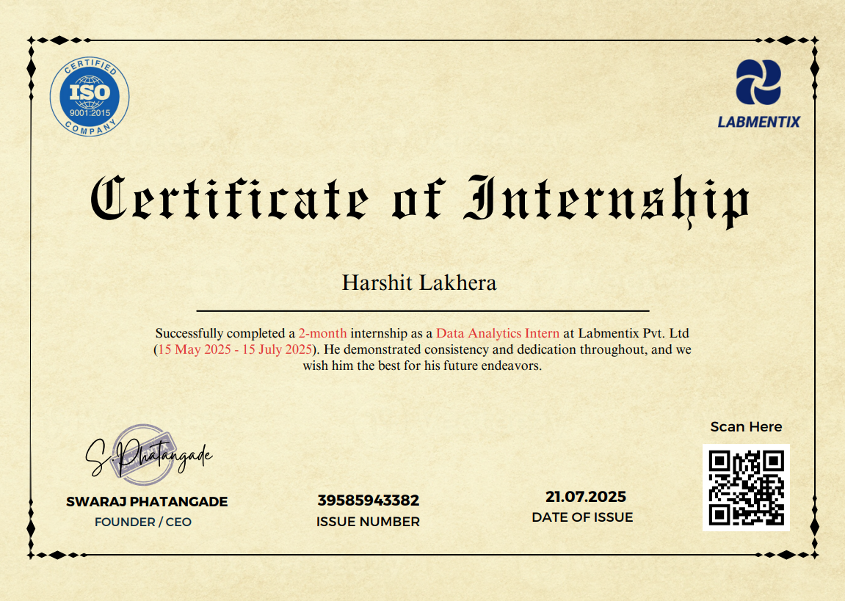
INTERNSHIP CERTIFICATE

Slide 4
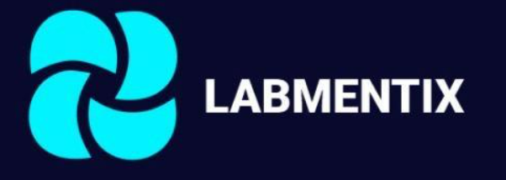
ORGANIZATION PROFILE
Services Offered:
Career and academic mentoring
Professional and leadership coaching
Online training programs
Corporate training solutions
Mission:
To empower individuals to realize their full potential by providing impactful mentorship and guidance.
Vision:
To be a trusted platform for learning, development, and personal growth.
Company Name : Labmentix pvt. ltd.
Founded : 2021
Industry: Mentorship, Career Development, Training Head Office: 2nd Floor, Umiya Emporium, opposite to Nexus Mall, Tavarekere, Kaveri Layout, Koramangala, Bengaluru, Karnataka 560030
Website: https://www.labmentix.in/
About the Company:
Labmentix Pvt. Ltd. is a mentoring and career development company that helps individuals enhance their skills, grow academically, and advance professionally through expert mentorship, training, and guidance.

Slide 5
NATURE OF INTERNSHIP
Job Profile: Data Analyst Intern
Time Period: 15th June 2025 – 15th August 2025 (2 Months)
Mode of Work: Online

Slide 6
INTERNSHIP ACTIVITIES
During the internship, I worked on a major project focusing on data visualization, generating reports.
Developed an Interactive Dashboard.
Focused on analyzing large data, visualization and storytelling.
Airbnb
Made an analysis and dashboard to understand Airbnb.
Focused on segmentation, balanced coverage, and in-depth trend analysis.

Slide 7
ASSIGNMENTS UNDERTAKEN
Week 1: Define objectives and explore the Airbnb dataset across neighborhoods. Week 2: Clean and preprocess the data, handling missing values, duplicates, and outliers. Week 3: Segment listings by price ranges, property types, and host categories. Week 4: Create basic visualizations such as popular neighborhood, property, and reviews. Week 5: Develop interactive Power BI dashboards with filters, maps, and trend charts. Week 6: Analyze pricing patterns, host behavior, and neighborhood trends. Week 7: Extract actionable insights on market segmentation, property demand, and pricing dynamics. Week 8: Present findings and document the complete project workflow and outcomes.

Slide 8
PROJECT DETAILS

Slide 9
PROJECT TITLE: Airbnb Dashboard
The aim of the project is to create a comprehensive and interactive dashboard analyzing Airbnb listings, providing insights into pricing trends, property distribution, and market segmentation by location, property type, and host category to support informed decision-making for hosts, guests, and market stakeholders.

Slide 10
OBJECTIVES & SCOPE
Analyze price variation across neighborhoods and host types.
Identify popular neighborhoods based on listing availability.
Compare business vs. individual hosts in pricing and reviews.
Study the distribution of property types in the market.
Analyze price variation across neighborhoods and host types.
Identify popular neighborhoods based on listing, total availability and total review.
Compare business vs. individual hosts in pricing and reviews.
Study the distribution of property types in the market.
Scope
Focus on Airbnb listings dataset (price, location, host type, property type).
Covers segmentation by price, neighborhood, host, and property type.
An interactive Power BI dashboard with key insights.

Slide 11
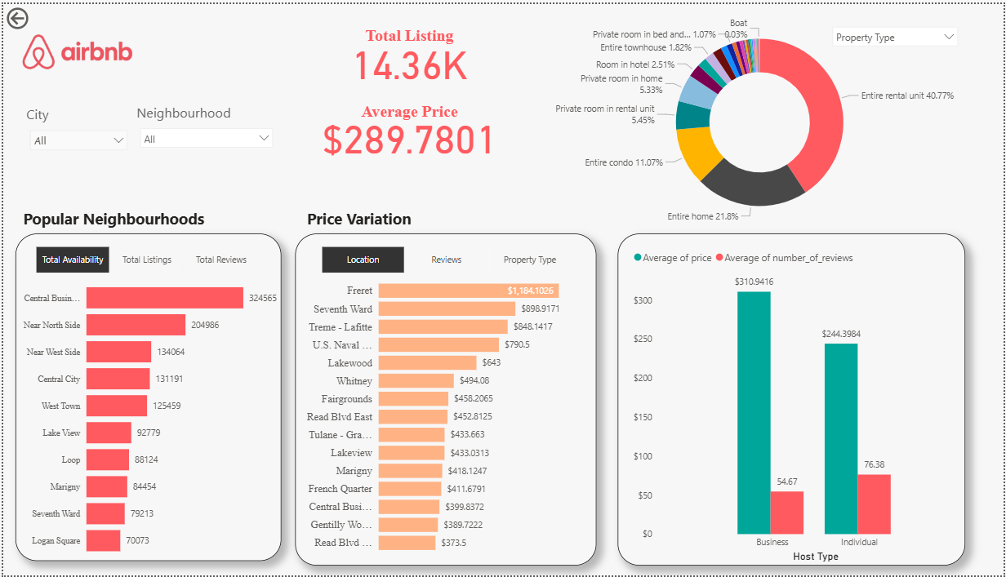

Slide 12
Data Preparation & Cleaning
Imported the Airbnb dataset for New Orleans and Chicago in Power BI for analysis.
Handled missing values in price, and reviews by imputing or removing incomplete records.
Removed duplicate listings to avoid redundancy.
Treated outliers in price and reviews to ensure reliable insights.

Slide 13
LEARNING EXPERIENCE

Slide 14
LEARNINGS & FUTURE GOAL
Learnings
Gained experience in cleaning, analyzing, and visualizing dataset.
Learned to extract insights on pricing trends, property types, host patterns, popular neighborhoods, and guest reviews.
Developed interactive dashboards to present key market metrics clearly.
Future Goals
Build predictive models for pricing, occupancy, and review trends.
Automate data updates for real-time insights.
Expand analysis to include seasonal trends, guest sentiment from reviews, and multiple regions for broader market understanding.
15

Slide 15

Thank You !!

